Slide 1
Population Methods

Slide 2
Population Methods
Instead of optimizing a single design point, population methods optimize a collection of individuals
A large number of individuals prevents algorithm from being stuck in a local minimum
Useful information can be shared between individuals
Stochastic in nature
Easy to parallelize

Slide 3
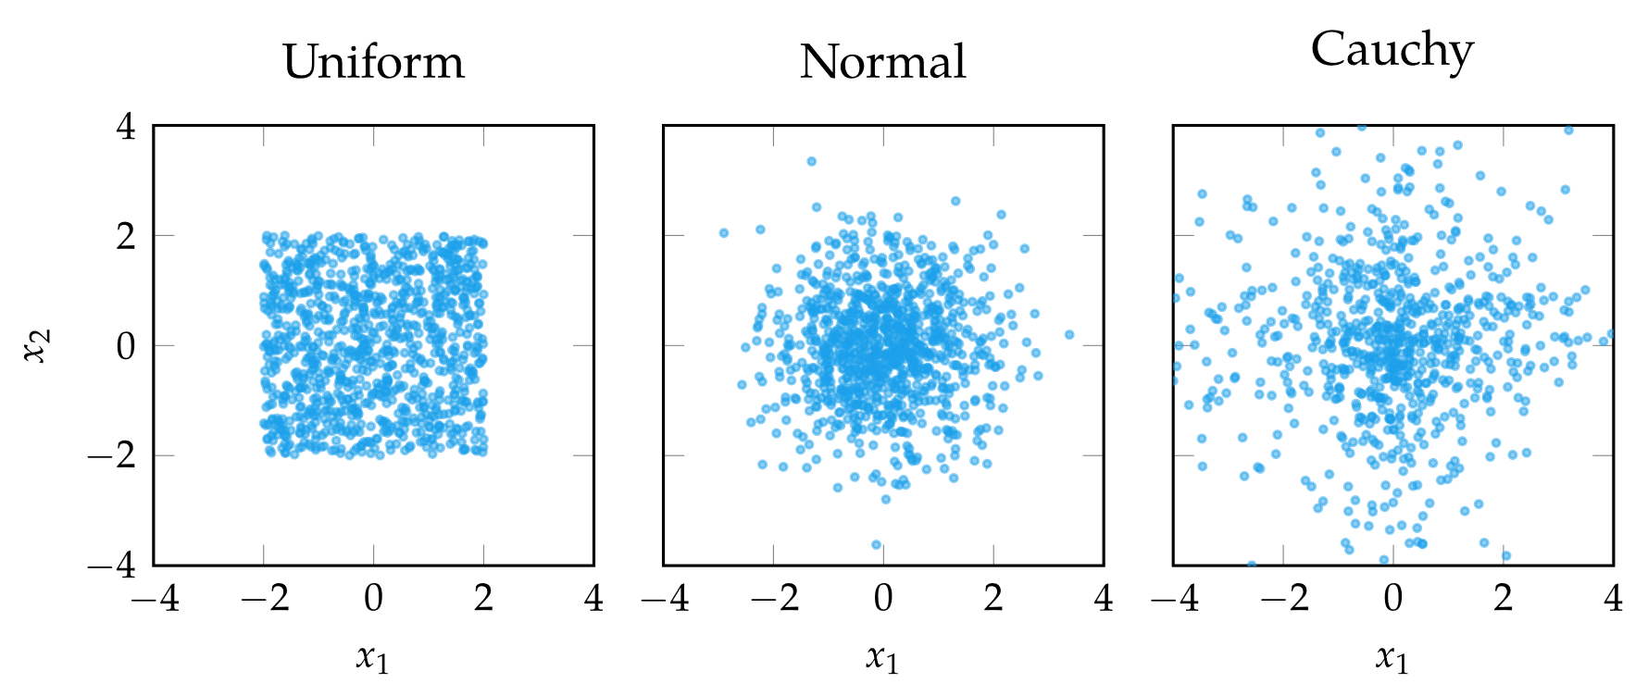

Initialization
Population methods begin with an initial population
Common initializations are uniform, normal distribution, and Cauchy distribution

Slide 4

Genetic Algorithms
Inspired by biological evolution where the fittest individuals pass their genetic information to the next generation
Individuals are interpreted as chromosomes
The fittest individuals are determined by selection
The next generation is formed by selecting the fittest individuals and performing crossover and mutation

Slide 5
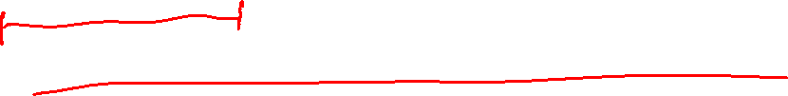
Genetic Algorithms: Chromosomes
Simplest representation is the binary string chromosome
Chromosomes are more commonly represented as real-valued chromosomes which are simply real-valued vectors
Typically initialized randomly

Slide 6

Genetic Algorithms: Selection
Determining which individuals pass their genetic information on to the next generation
Truncation selection: truncate the lowest performers
Tournament selection: selects fittest out of k randomly chosen individuals
Roulette Wheel selection: individuals are chosen with probability proportional to their fitness

Slide 7
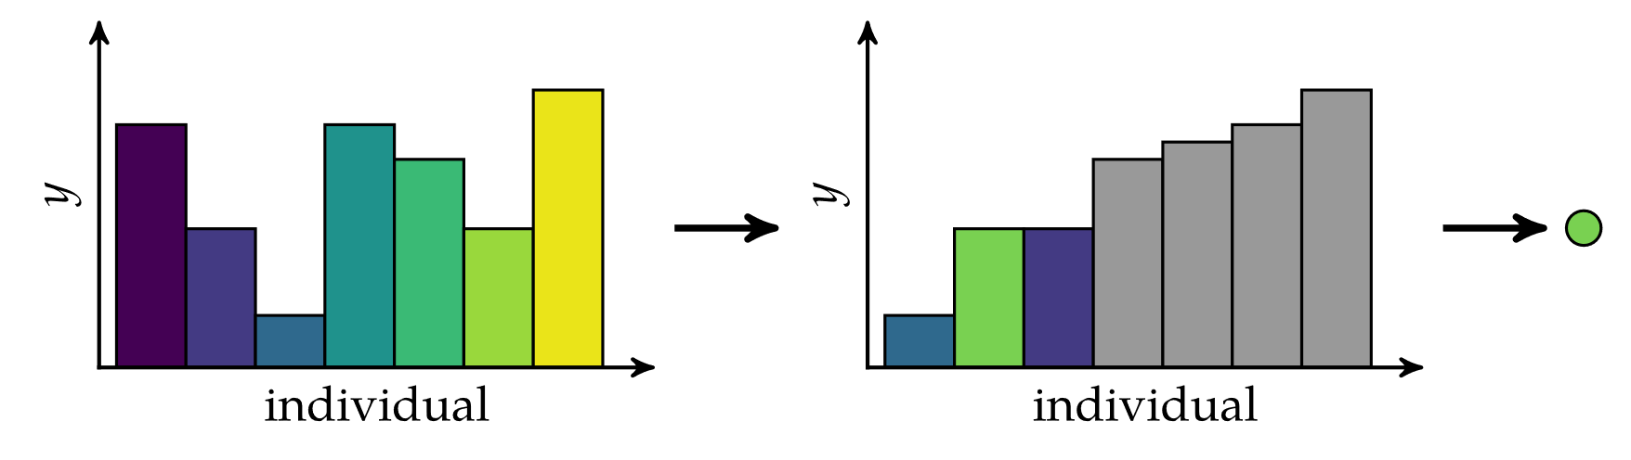
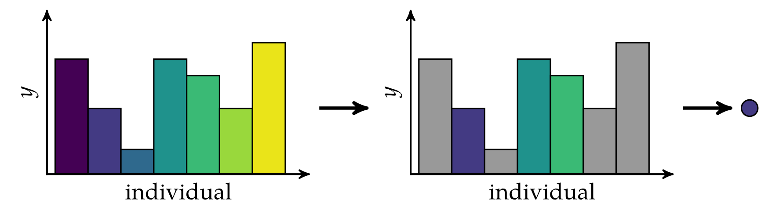
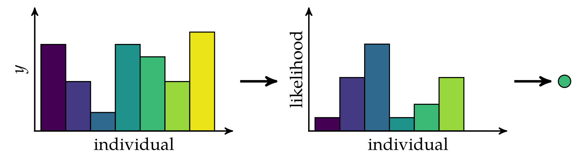
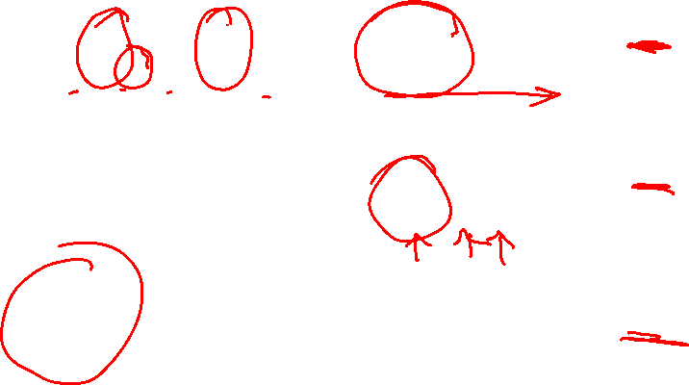
Genetic Algorithms: Selection
Truncation Selection
Tournament Selection
Roulette Wheel Selection

Slide 8
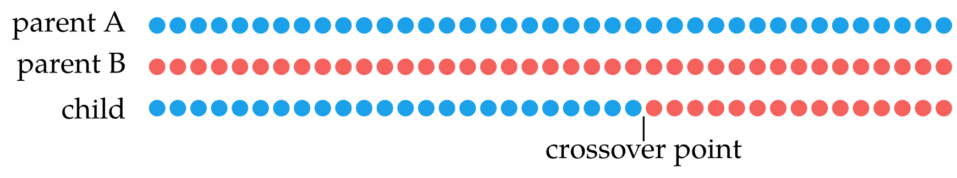
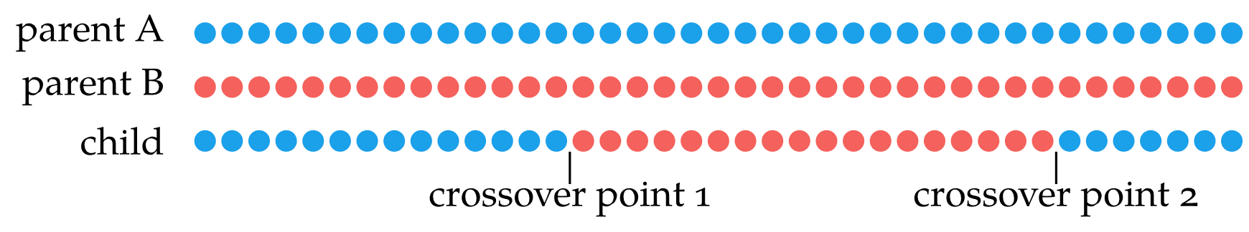
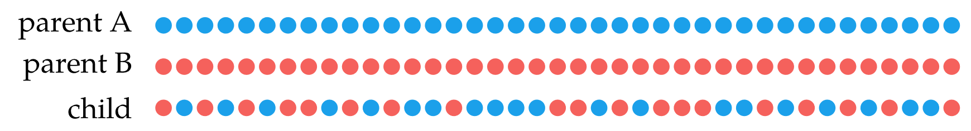

Genetic Algorithms: Crossover
Combines the chromosomes of the parents to form children
Single-point crossover: swap occurs after single crossover point
Two-point crossover: two crossover points
Uniform crossover: each bit has 50% chance of crossover

Slide 9
Genetic Algorithms: Mutation
Mutation supports exploration of new areas of design space
Each bit or real-valued element can has a probability of being flipped or modified by noise
The probability of an element mutating is called mutation rate

Slide 10
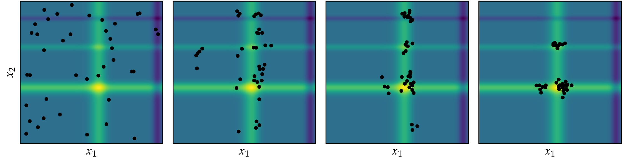
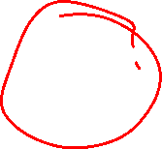
Genetic Algorithms
Genetic algorithm with truncation selection, single point crossover, and Gaussian mutation applied to Michalewicz function

Slide 11
Differential Evolution
Improves each individual x by recombining other individuals according to a simple formula
Choose three random, distinct individuals a, b, and c
Construct interim design z = a + w(b - c)
Choose a random dimension to optimize in
Construct candidate x’ via binary crossover of x and z
Insert better design between x and x’ into next generation

Slide 12
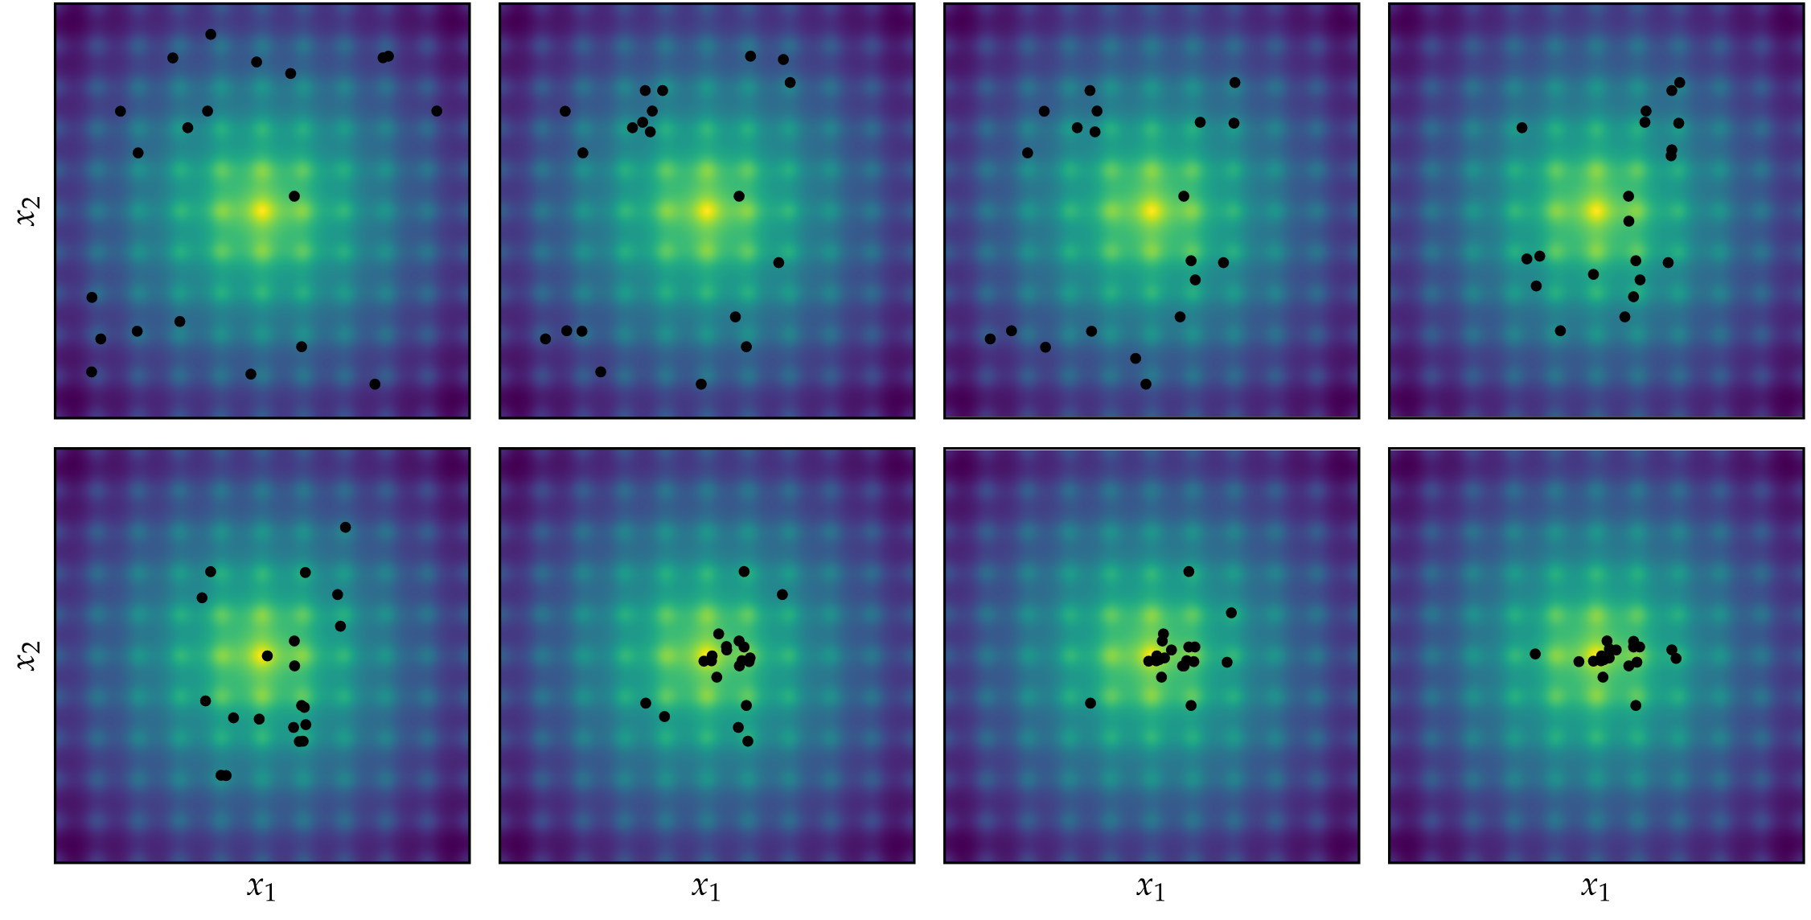
Differential Evolution

Slide 13

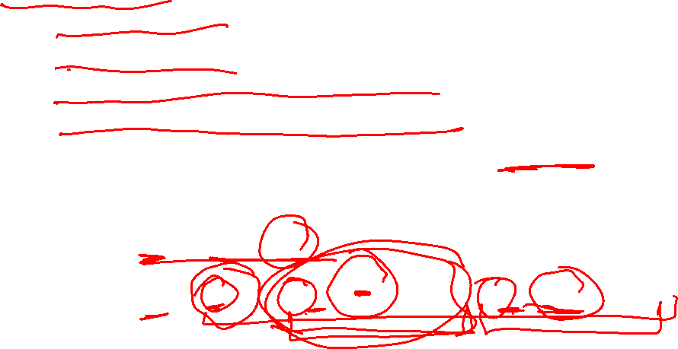
Particle Swarm Optimization
Each individual, or particle, tracks the following
Current position
Current velocity
Best position seen so far by the particle
Best position seen so far by any particle
At each iteration, these factors produce “force” and “momentum” effects to determine each particle’s movement

Slide 14
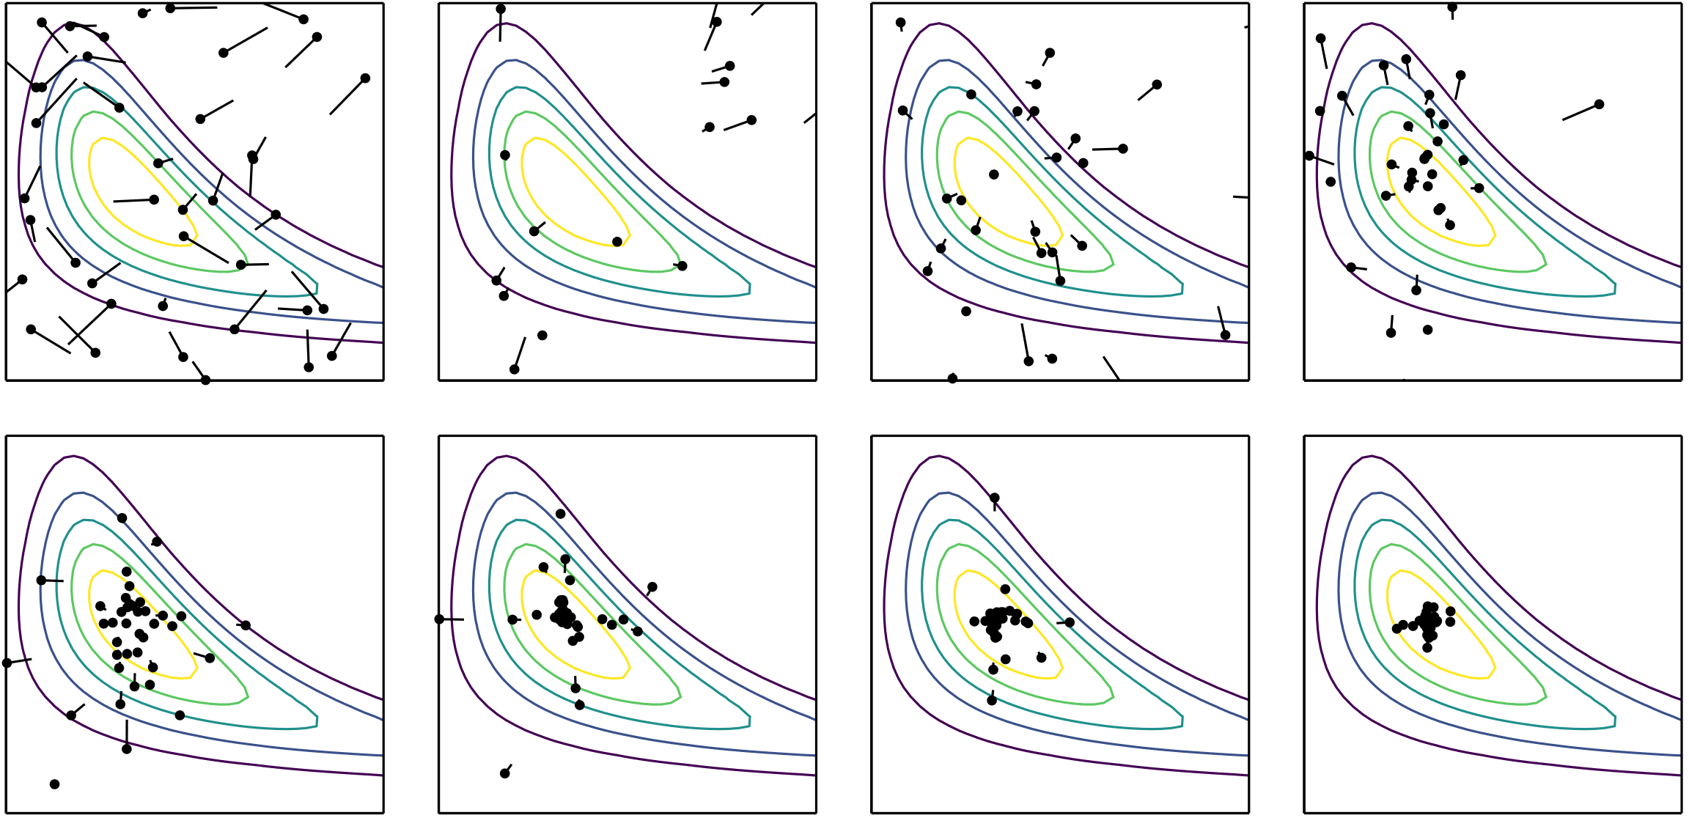
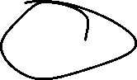
Particle Swarm Optimization

Slide 15
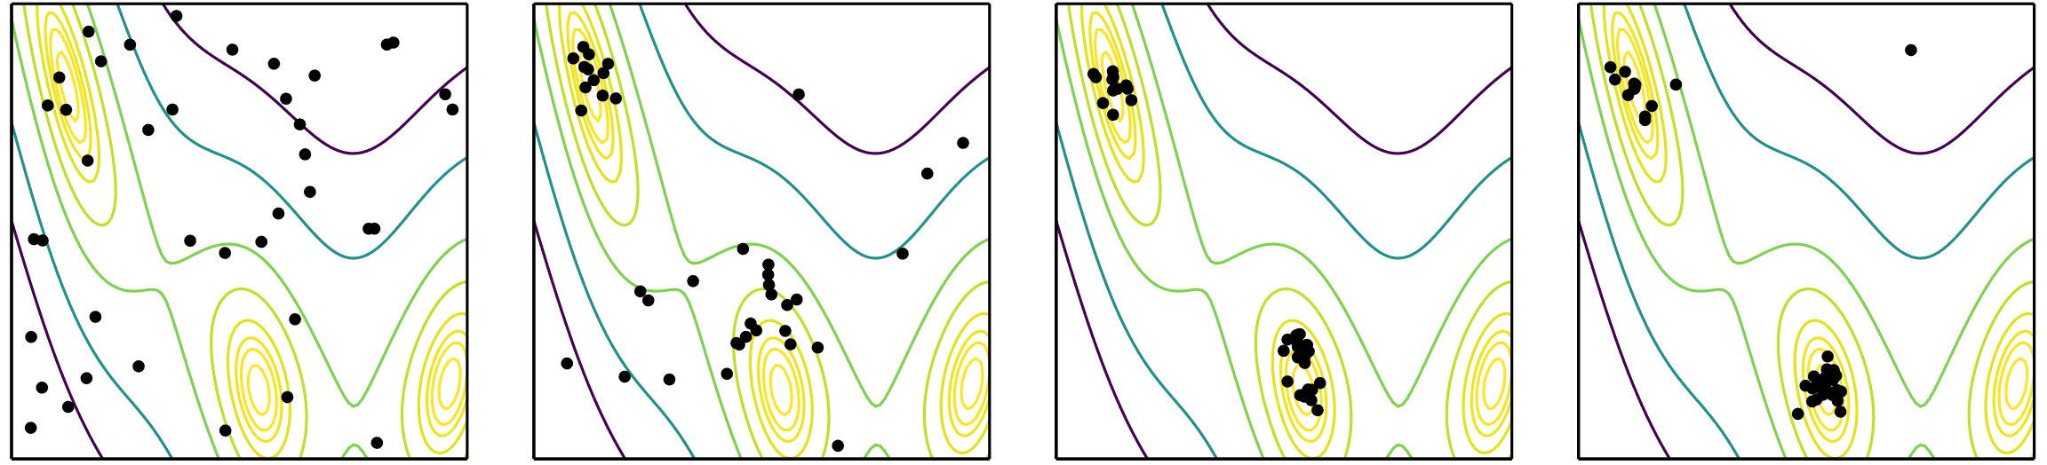
Firefly Algorithm
Inspired by the way fireflies flash their lights to attract mates
Attractiveness is determined by low function value
At each iteration, fireflies move toward the most attractive lights
Random noise is added to increase exploration

Slide 16
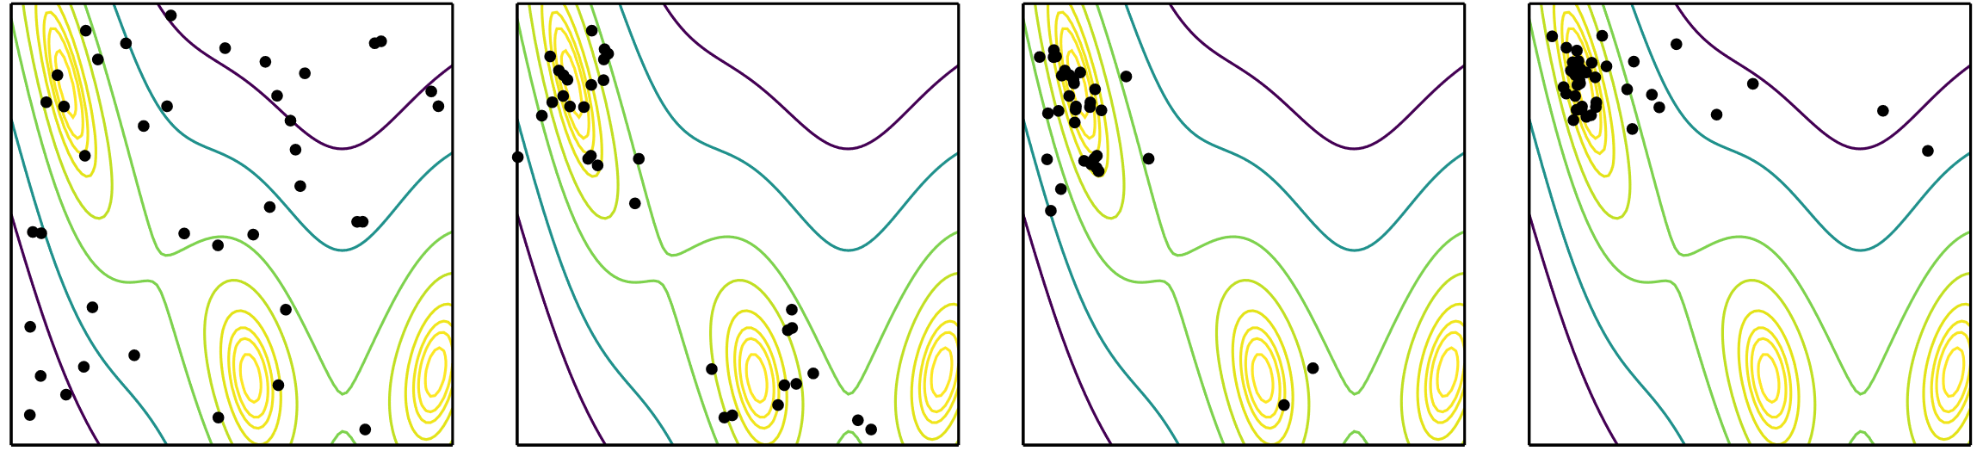
Cuckoo Search
Inspired by Cuckoos which lay eggs in other birds nests with the hope they will be raised by the other birds
Design points represent nests
A cuckoo lays an egg in a randomly chosen nest
The best nests with the best eggs survive the next generation
Some eggs are discovered by host bird and destroyed

Slide 17
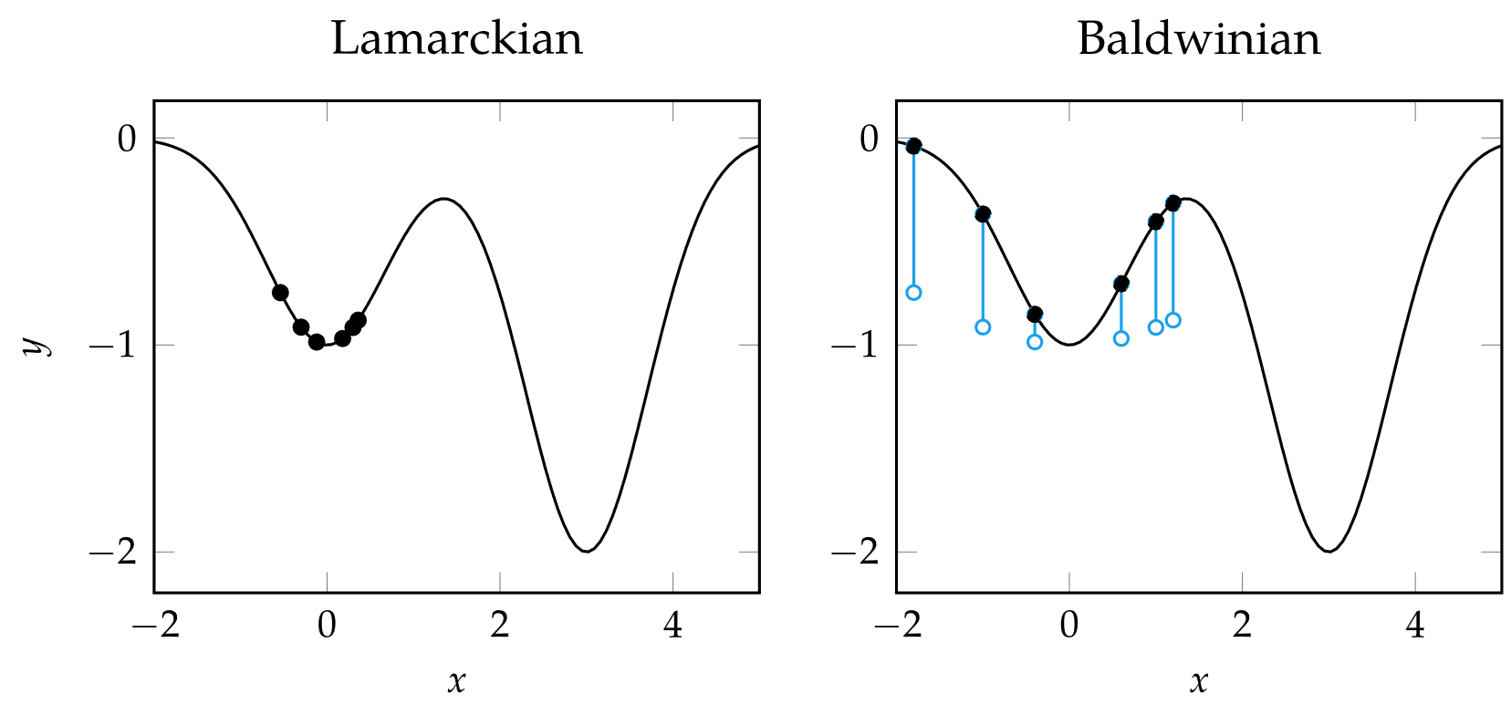
Hybrid Methods
Lamarckian learning
Performs regular descent method update on each individual
Baldwinian learning
Uses value of descent method update to augment the objective value of each design point

Slide 18
Summary
Population methods use a collection of individuals in the design space to guide progression toward an optimum
Genetic algorithms leverage selection, crossover, and mutations to produce better subsequent generations
Differential evolution, particle swarm optimization, the firefly algorithm, and cuckoo search include rules and mechanisms for attracting design points to the best individuals in the population while maintaining suitable state space exploration
Population methods can be extended with local search approaches to improve convergence

